Slide 1
What Does it Take to Win an OBIE?

Slide 2
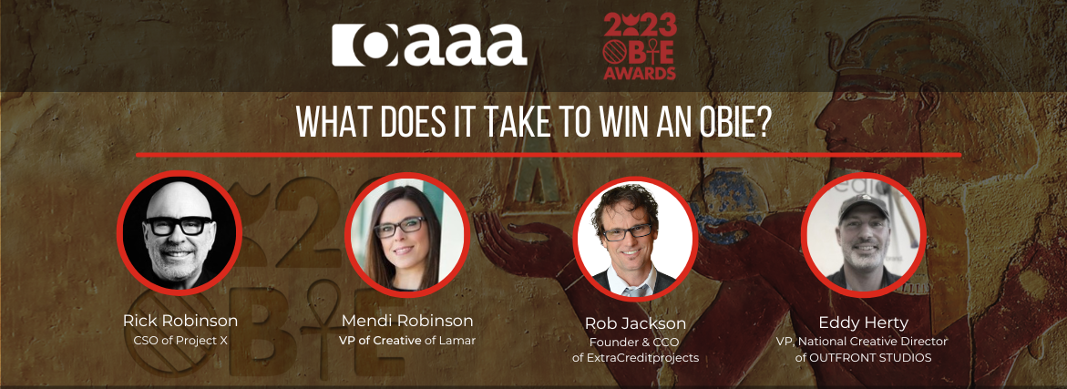
Today’s Agenda
Panelist Introductions
Judging
Favorite Winning OBIE Campaigns
Q&A

Slide 3
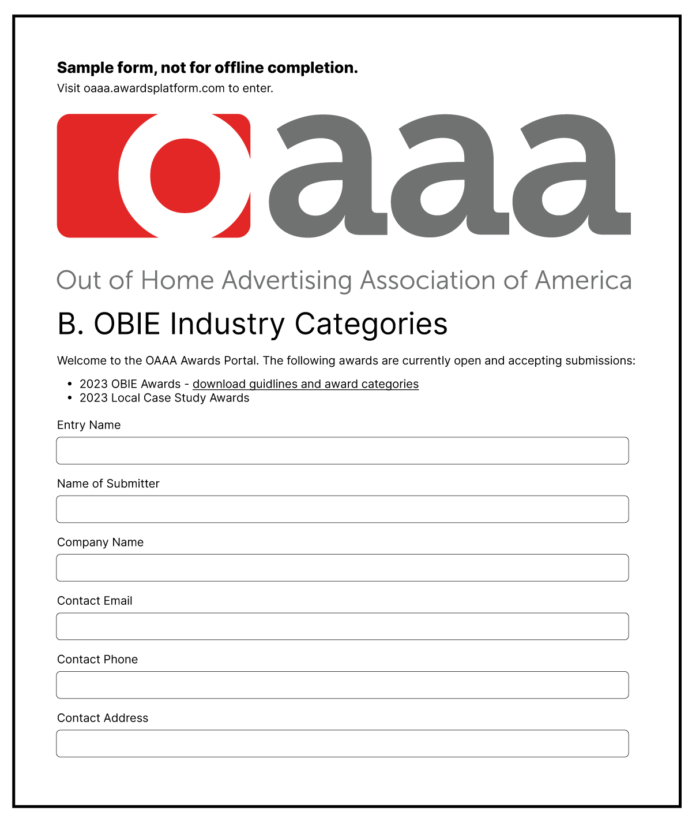
Judging
What does it mean to be an OBIE Awards Judge?
What do judges look for in a submission to deem it worthy of receiving an award?
What are the best ways to utilize the entry submission form to strengthen your odds of winning?

Slide 4
Favorite Winning
OBIE Campaigns

Slide 5
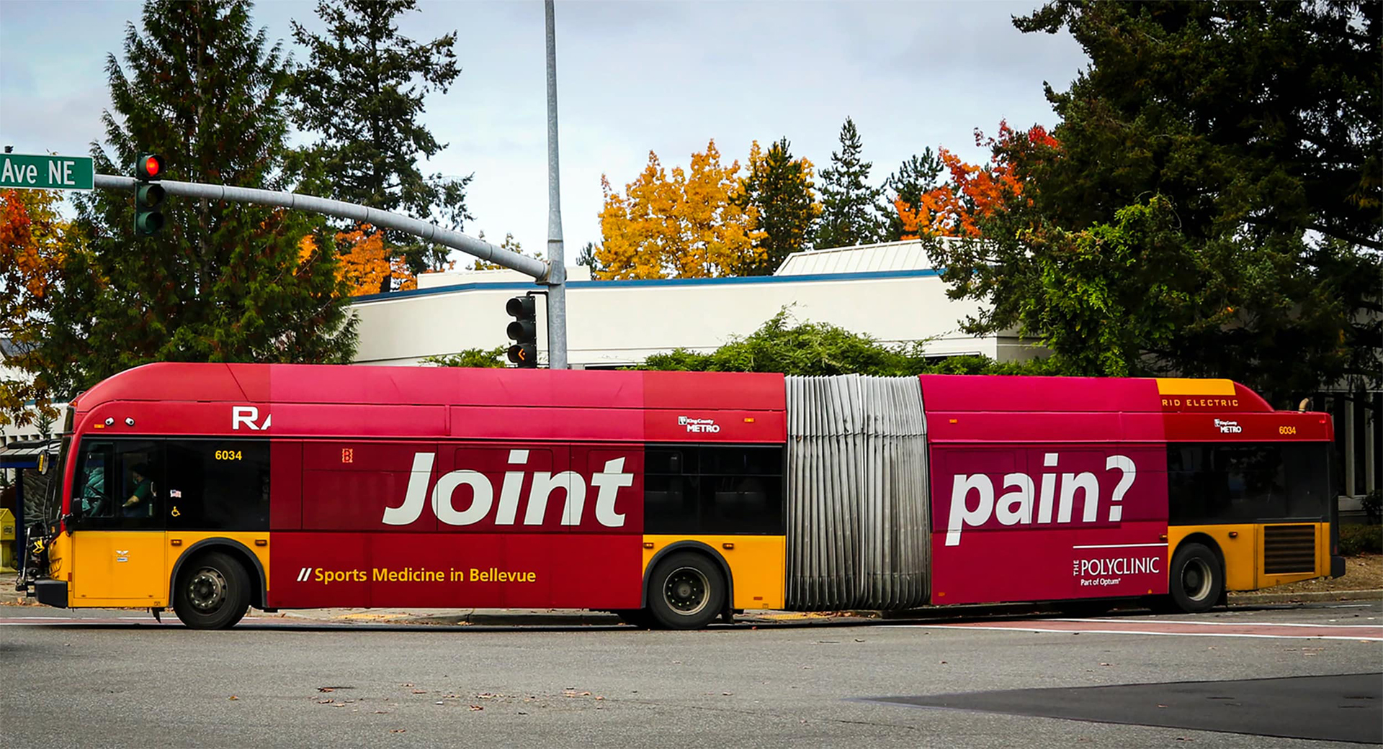
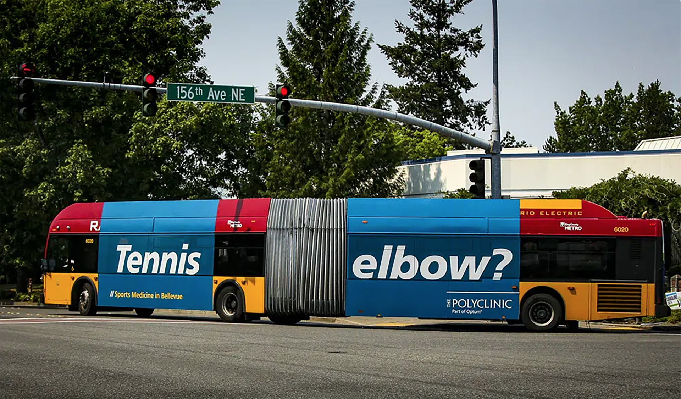
Bendy Buses
Notes:
Rob Example 1

Slide 6
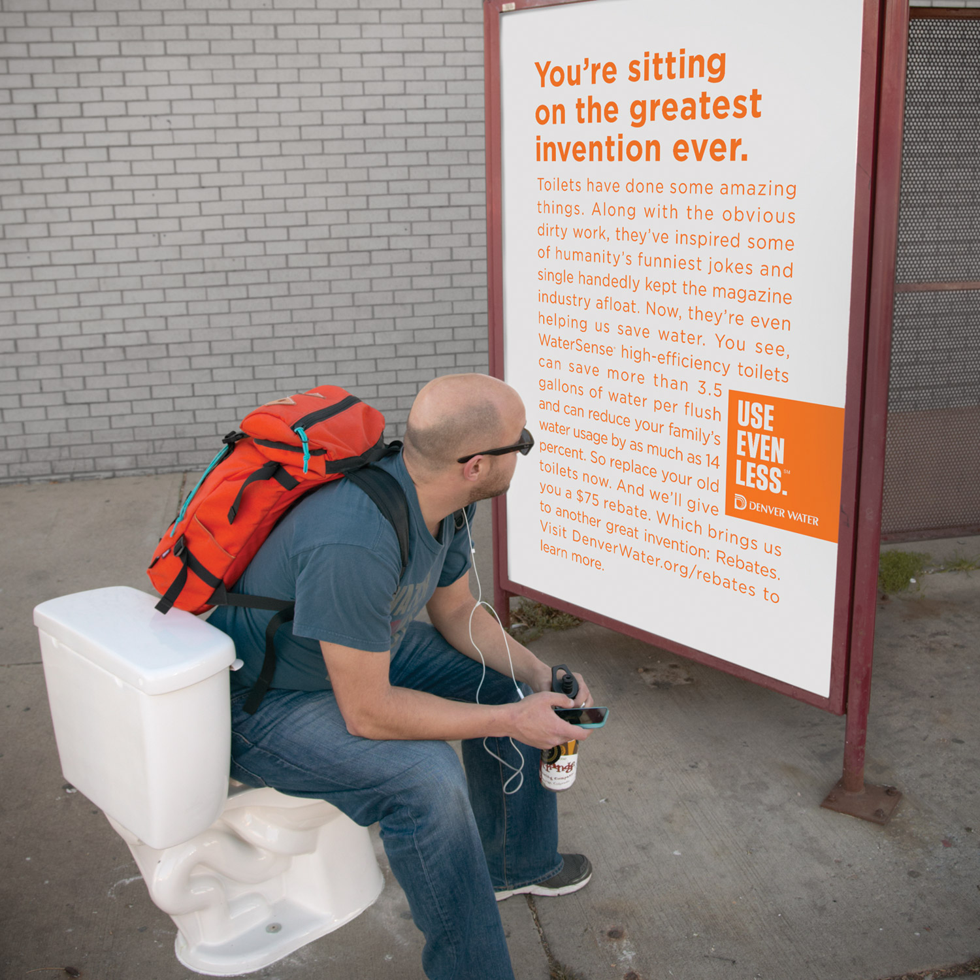
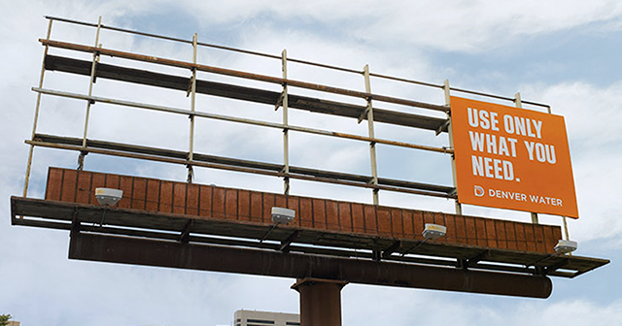
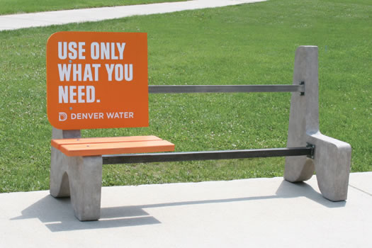
Denver Water
Notes:
Mendi Example 1

Slide 7
Fairmount Funeral Home
Notes:
Eddy Example 1

Slide 8
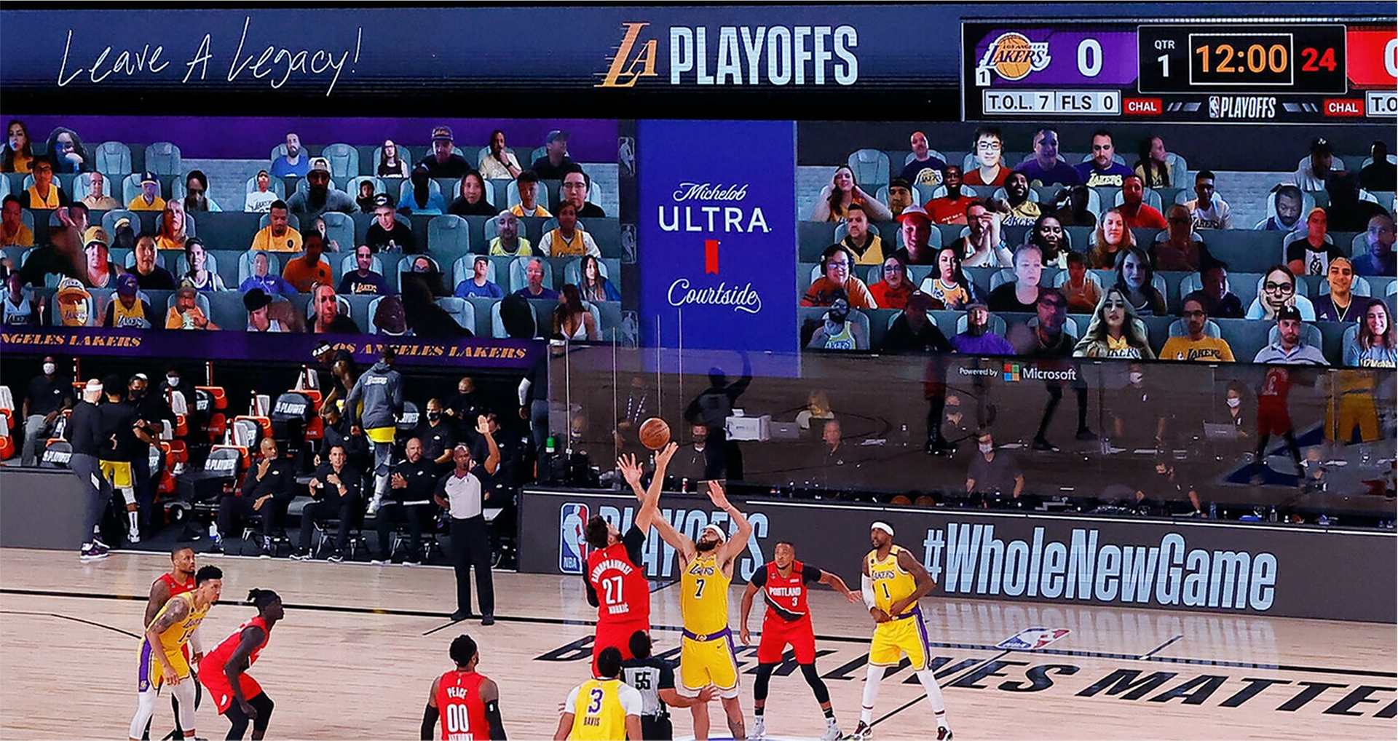
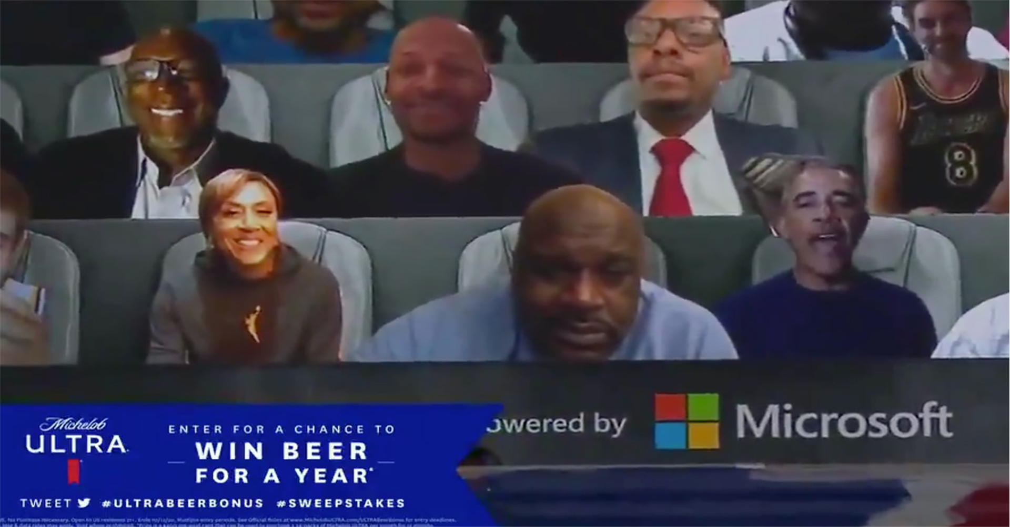
Michelob ULTRA Courtside: Game Changing Innovation Changes the Game
Notes:
Rob Example 2

Slide 9
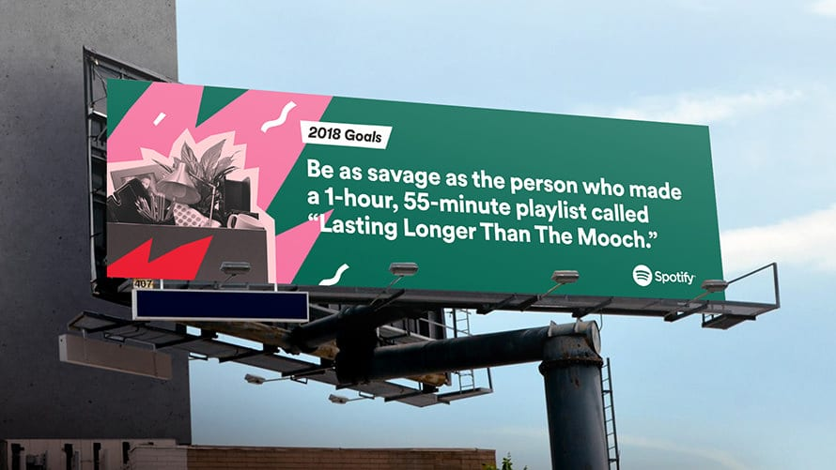
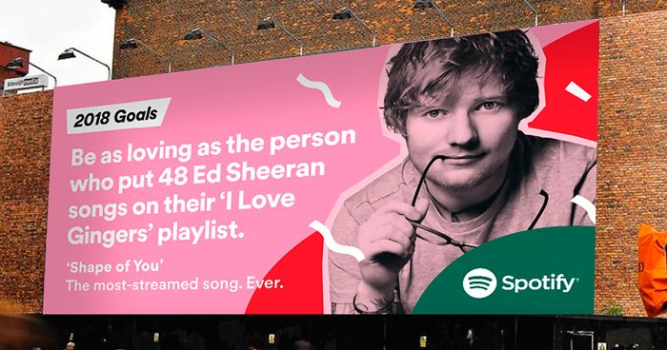
Spotify
Notes:
Mendi Example 2

Slide 10
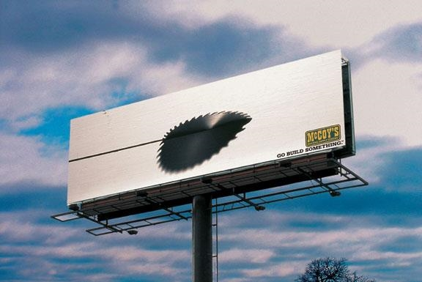
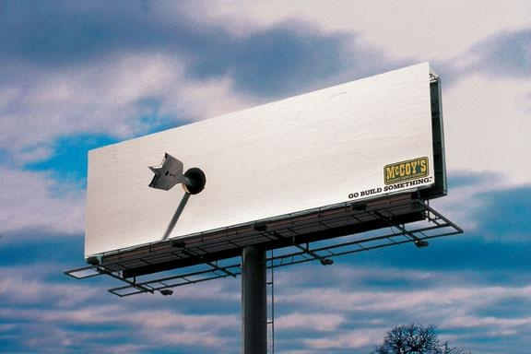
McCoy’s
Notes:
Eddy Example 2

Slide 11
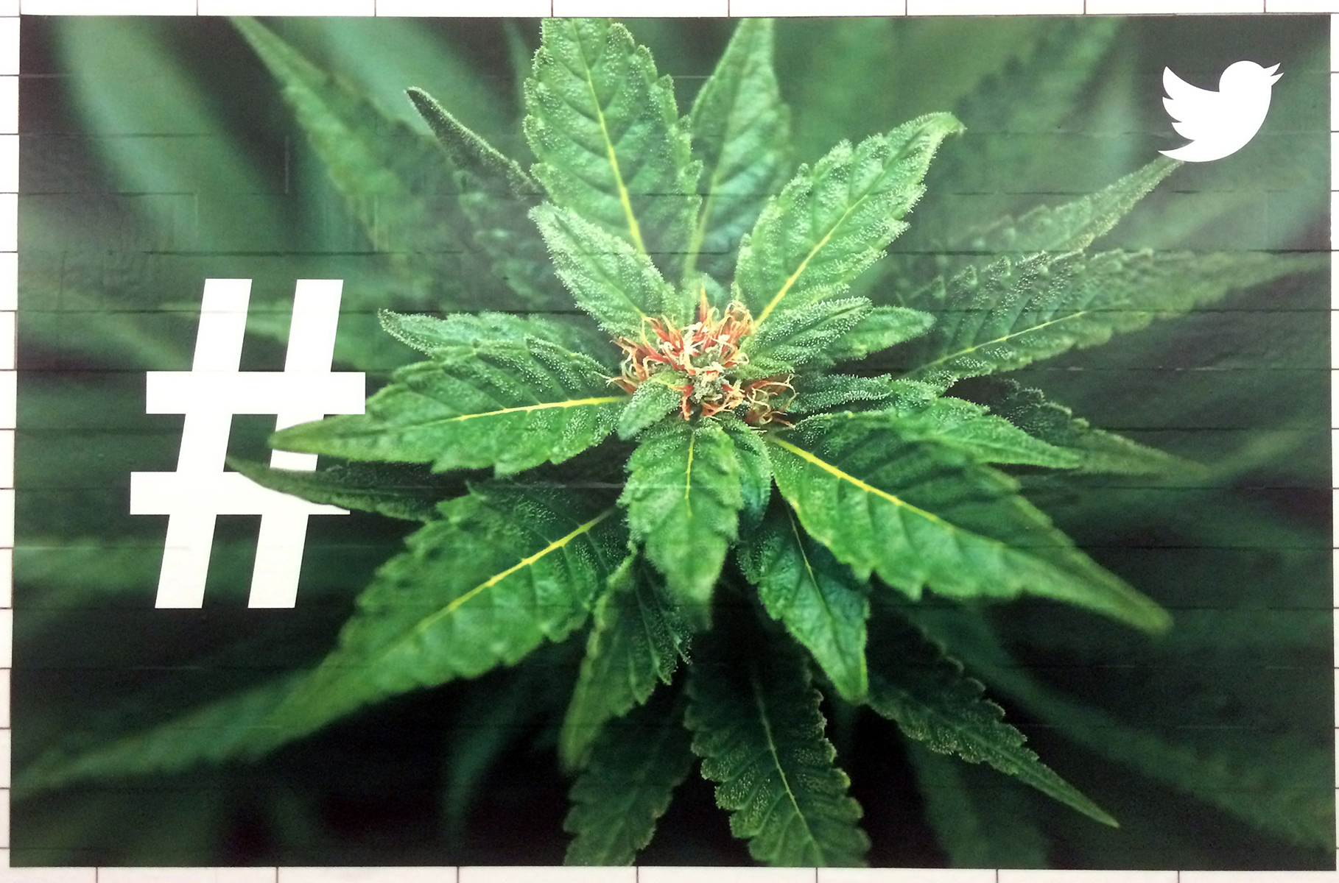
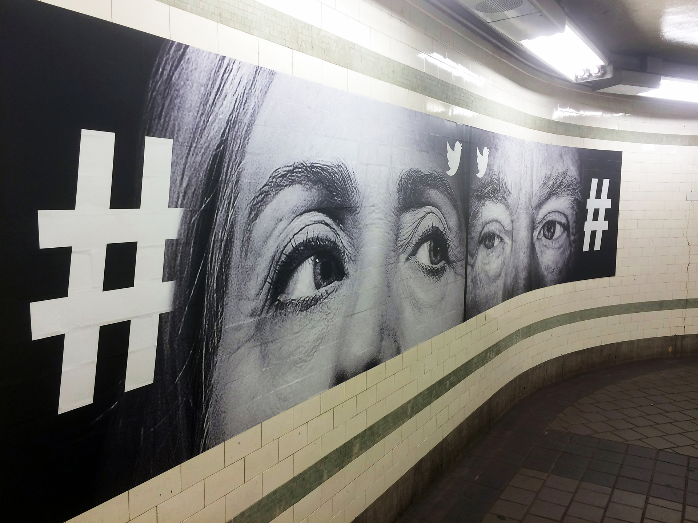
Twitter
Notes:
Rob Example 3

Slide 12
Montefiore
Notes:
Mendi Example 3

Slide 13
Mini Cooper
Notes:
Eddy Example 3

Slide 14
Enjoy the View
Notes:
Rob Example 4

Slide 15
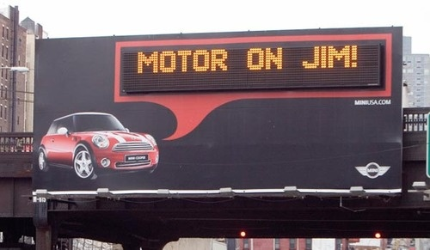
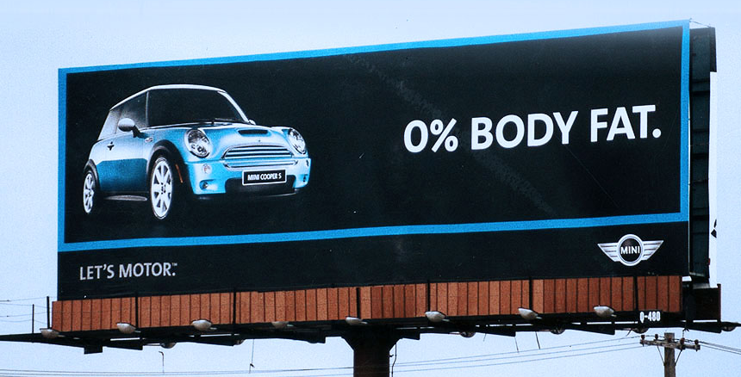
Mini Cooper
Notes:
Mendi Example 4

Slide 16
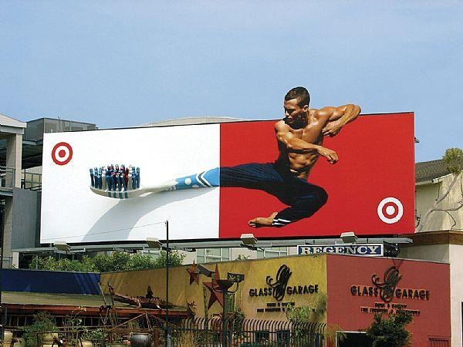
Target
Notes:
Eddy Example 4

Slide 17
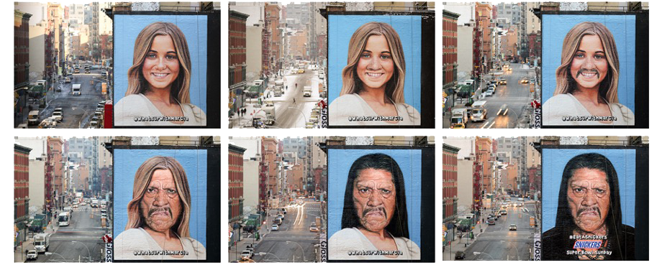
Snickers
Notes:
Rob Example 5

Slide 18
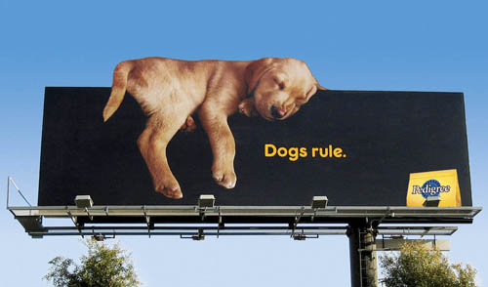
Pedigree
Notes:
Eddy Example 5

Slide 19
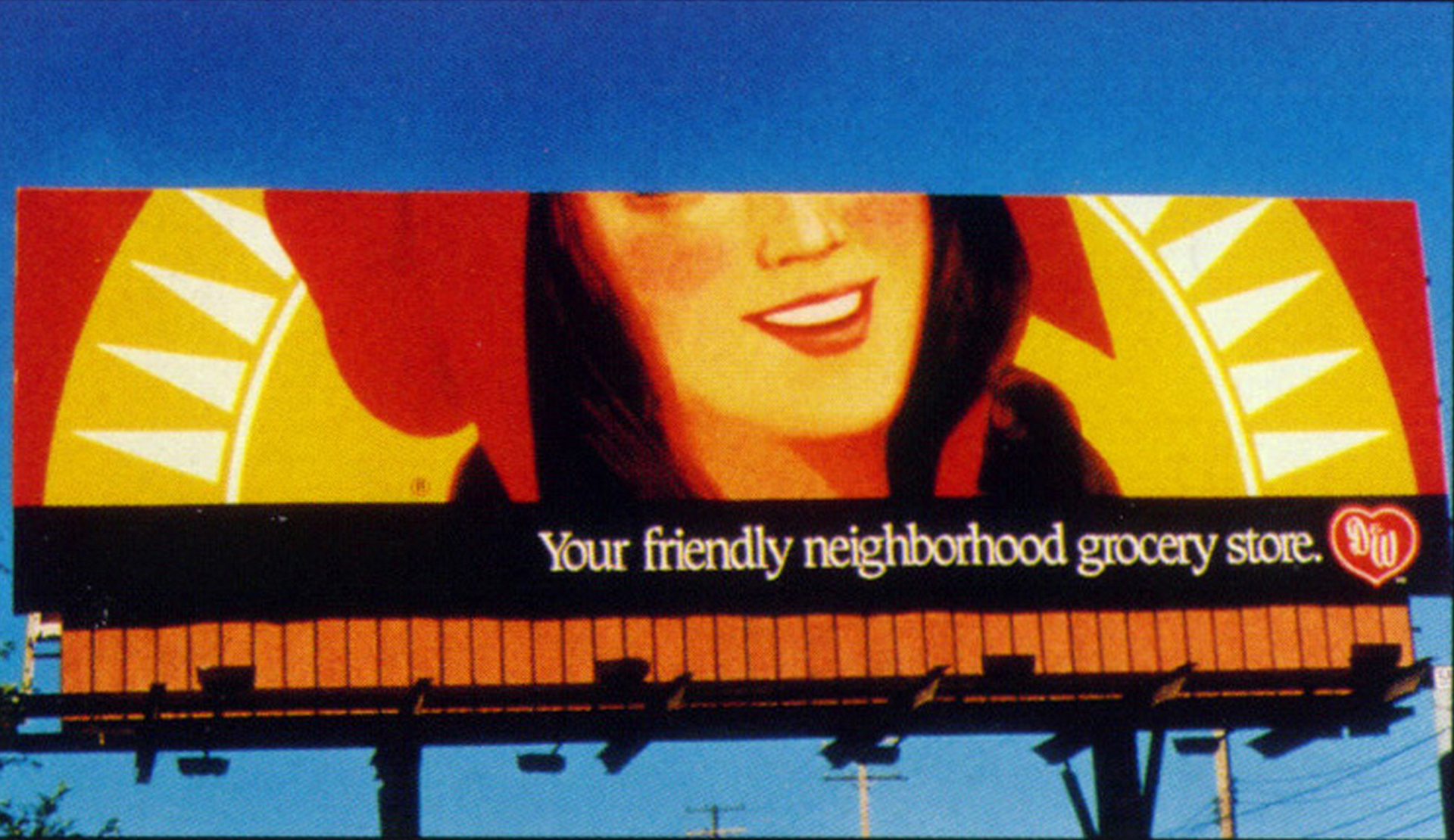
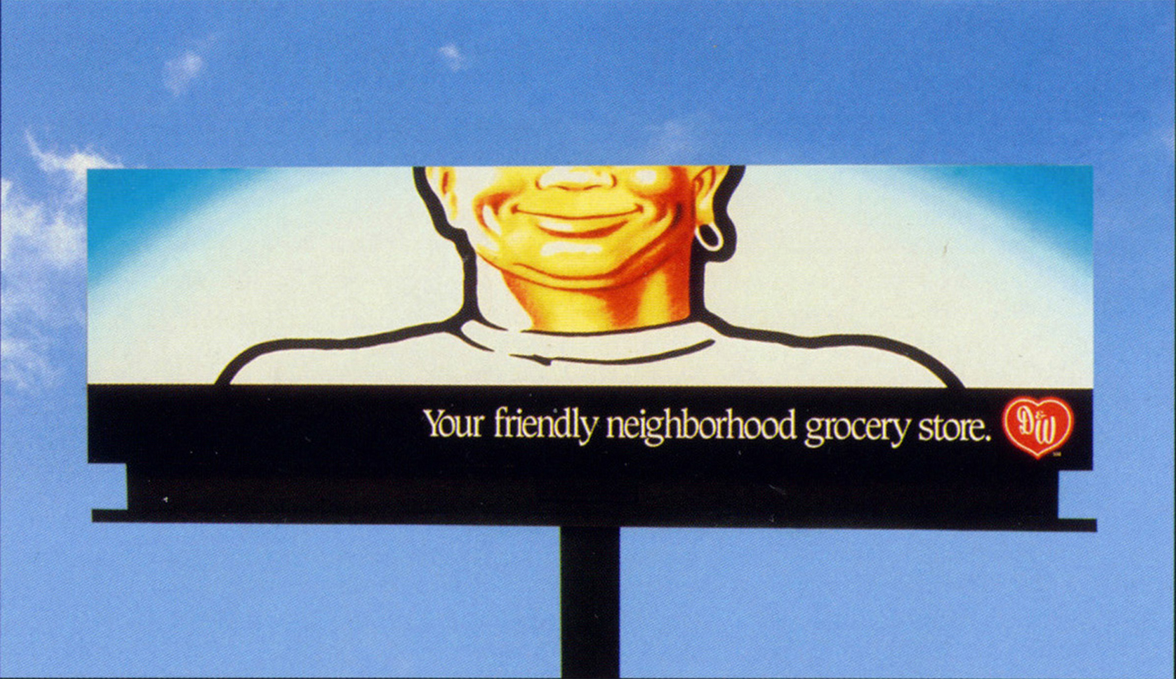
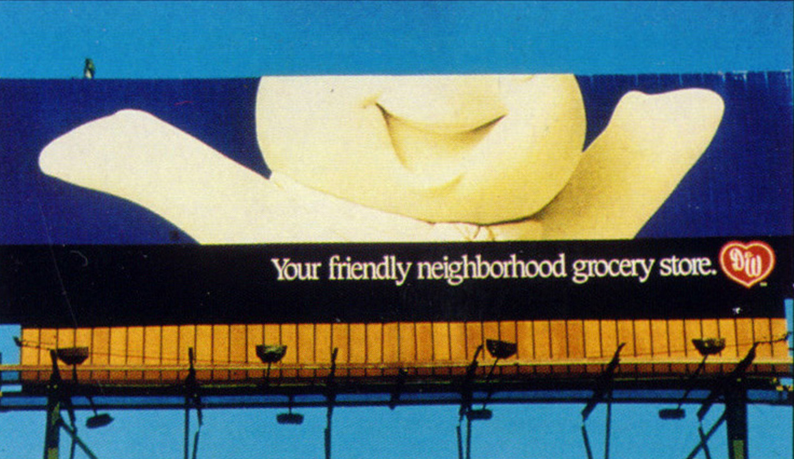
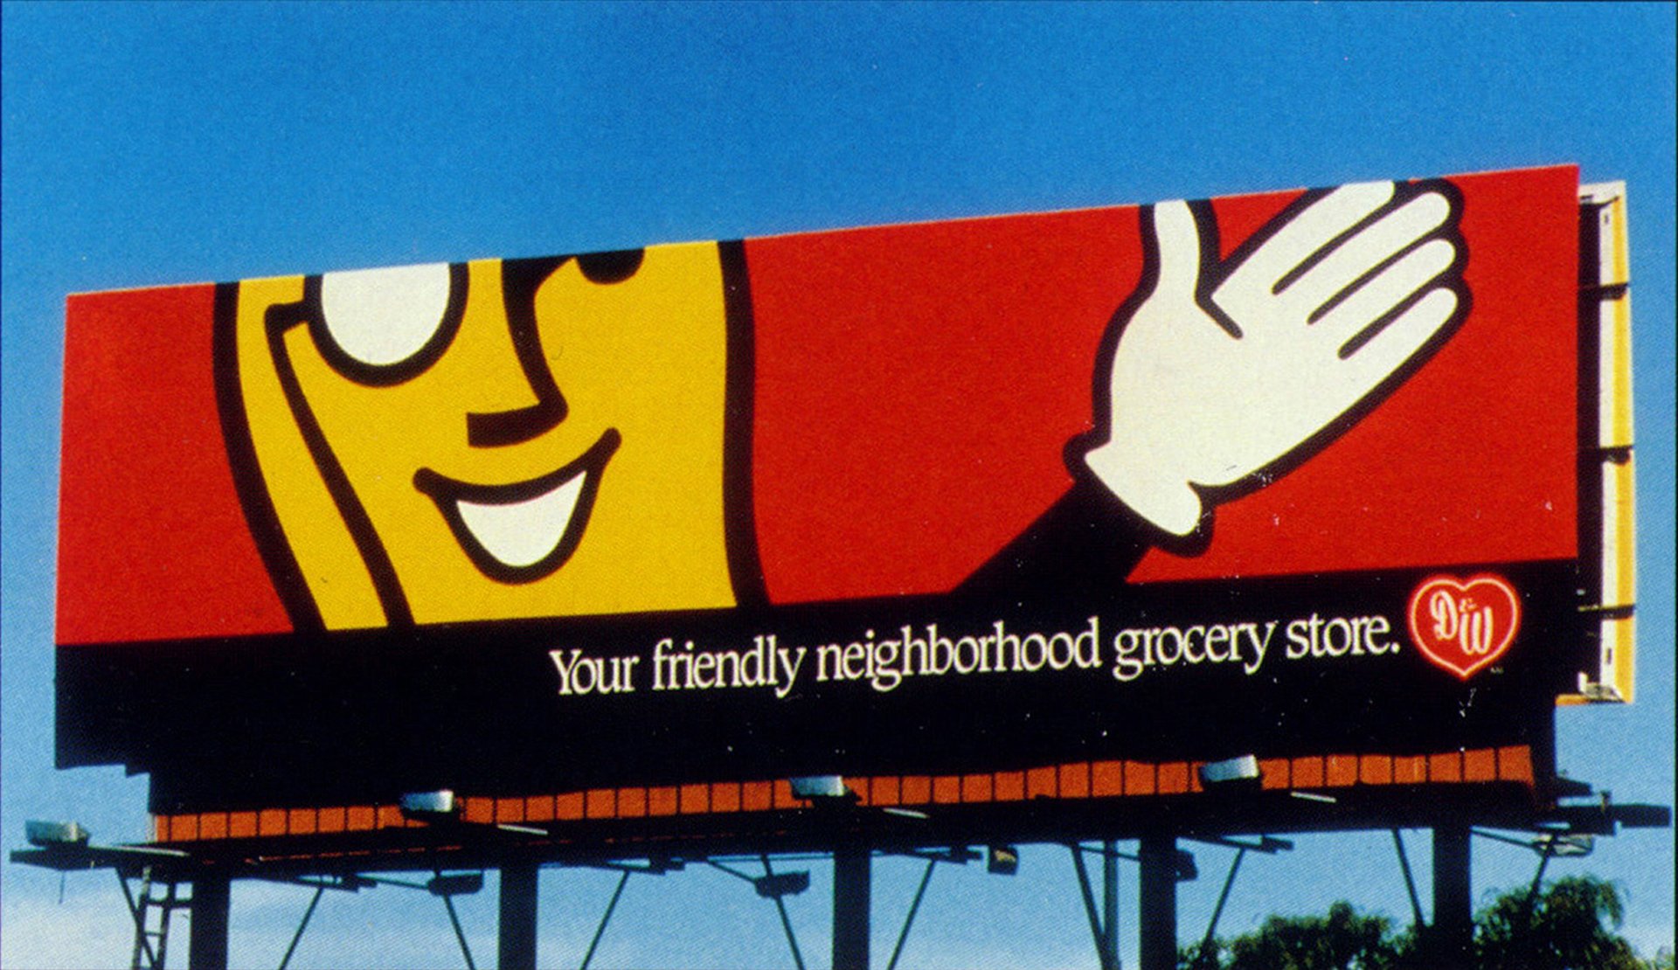
D&W
Notes:
Rob Example 6

Slide 20
Q&A

